Slide 1
Memory Allocation
Adelaiye O.I

Slide 2
Objectives
Data allocation
Data types and sizes
Pointers to objects in memory
MOV instruction, copying data
Exchange Instructions
sign-extending integer

Slide 3
Allocating Memory for Integers
Intel x86 CPU performs operations on different sizes of data.
An integer is a whole number with no fractional part.
In assembler, the variables are created by data allocation directives.
Assembler declaration of integer variable assigns a label to a memory space allocated for the integer.

Slide 4
Allocating Memory Cont’d
The variable name becomes a label for the memory space. For example,
MyVar db 77h ; byte-sized variable called MyVar initialised to 77h where
MyVar is variable name
db is directive for byte-sized memory allocation
77h is initializer specifying initial value.

Slide 5
Endian
Different processors store multi-byte integers in different orders in memory.
There are two popular methods of storing integers: big endian and little endian.
Big endian method is the most natural:
the biggest (i.e. most significant) byte is stored first, then the next biggest, etc.
IBM mainframes, most RISC processors and Motorola processors all use this big endian method.

Slide 6
Endian Cont’d
However, Intel-based processors use the little endian method, in which the least significant byte is stored first.
Normally, the programmer does not need to worry about which format is used, unless
Binary data is transfered between different computers e.g. over a network.
All TCP/IP headers store integers in big endian format (called network byte order.)
Binary data is written out to memory as a multibyte integer and then read back as individual bytes or vise versa.

Slide 7
Endian Explained
 |  | Byte sequence order
Data type | Value^{(*)} | Big endian | Little endian
WORD | 1234 | 12 34 | 34 12
DWORD | 47D5A8 | 00 47 d5 a8 | a8 d5 47 00
DWORD | 56789ABC | 56 78 9a bc | bc 9a 78 56

Slide 8
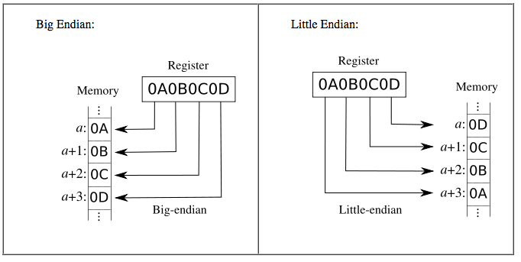
Endian Explained

Slide 9
Abbreviated Data Allocation
Multiple definitions can be abbreviated.
For example,
message DB 'B'
DB 'y'
DB 'e'
DB 0DH
DB 0AH
can be written as
message DB 'B', 'y', 'e', 0DH, 0AH
and even more compactly as
message DB 'Bye', 0DH, 0AH

Slide 10
Multi-bytes
Multiple definitions can be cumbersome to initialize data structures such as arrays
For example, to declare and initialize an integer array of 8 elements
values DW 0, 0, 0, 0, 0, 0, 0, 0
What if we want to declare and initialize to zero an array of a lot more elements?
Assembler provides a better way of doing this by DUP directive:
values DW 8 DUP (0)

Slide 11
Symbol Table
For multiple data directives Assembler builds a symbol table
Both offset (in bytes) and label refer to the allocated storage space in memory:
.DATA
value DW 0
sum DD 0
marks DW 10 DUP (?)
message DB 'The grade is:',0
char1 DB ?
Label Name | Memory offset
Value | 0
sum | 2
marks | 6
message | 26
char1 | 40

Slide 12
Similarity with C Data Type
Directive | C Data type
DB | Char
DW | Int, Unsigned int
DD | Float, long
DQ | double
DT | Internal intermediate float value

Slide 13
Keyword | Description
BYTE, DB (byte) | Allocates unsigned numbers from 0 to 255.
SBYTE (signed byte) | Allocates signed numbers from 128 to +127.
WORD, DW (word = 2 bytes) | Allocates unsigned numbers from 0 to 65,535 (64K).
SWORD (signed word) | Allocates signed numbers from 32,768 to +32,767.
DWORD, DD (doubleword = 4 bytes) | Allocates unsigned numbers from 0 to 4,294,967,295 (4 megabytes)
SDWORD (signed doubleword) | Allocates signed numbers from 2,147,483,648 to +2,147,483,647.
FWORD, DF (farword = 6 bytes) | Allocates 6-byte (48-bit) integers. These values are normally used only as pointer variables on the 80386/486 processors.
QWORD, DQ (quadword = 8 bytes) | Allocates 8-byte integers used with 8087-family coprocessor instructions.
TBYTE, DT (10 bytes) | Allocates 10-byte (80-bit) integers if the initializer has a radix specifying the base of the number.

Slide 14
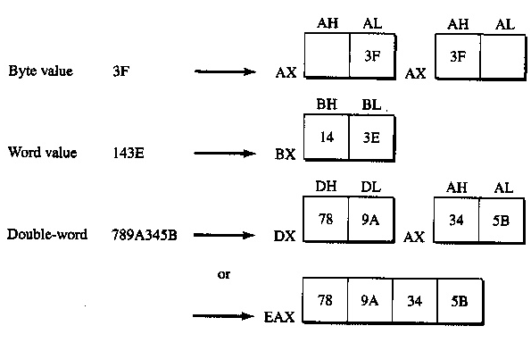
Data Storage in register

Slide 15
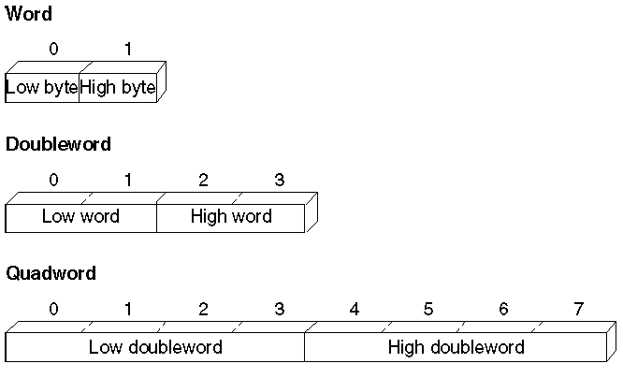
The data types SBYTE, SWORD, and SDWORD tell the assembler to treat the initializers as signed data.

Slide 16
Pointer Operator
CPU has instructions to copy, move, and sign-extend integer values.
These instructions require operands to be the same size.
However, we may need to operate on data with size other than that originally declared.
The PTR operator forces expression to be treated as the specified type:
.DATA
num DWORD 0
.CODE
mov ax, WORD PTR num[0] ; Load a word-size value from
mov dx, WORD PTR num[2] ; a doubleword variable
PTR operator re-casts the DWORD-sized memory location pointed by num[ index ] expression into a WORD-sized value.

Slide 17
Copying Data Values
The primary instructions for moving data from operand to operand and loading them into registers are
MOV (Move)
XCHG (Exchange)
CWD (Convert Word to Double)
CBW (Convert Byte to Word).

Slide 18
MOV Instruction
MOV copies the source operand to the destination operand without affecting the source.
; Immediate value moves
mov ax, 7 ; Immediate to register
mov mem, 7 ; Immediate to memory direct
mov mem[bx], 7 ; Immediate to memory indirect
; Register moves
mov mem, ax ; Register to memory direct
mov mem[bx], ax ; Register to memory indirect
mov ax, bx ; Register to register
mov ds, ax ; General register to segment register
; Direct memory moves
mov ax, mem ; Memory direct to register
mov ds, mem ; Memory to segment register
; Indirect memory moves
mov ax, mem[bx] ; Memory indirect to register
mov ds, mem[bx] ; Memory indirect to segment register

Slide 19
MOV Instructions
; Segment register moves
mov mem, ds ; Segment register to memory
mov mem[bx], ds ; Segment register to memory indirect
mov ax, ds ; Segment register to general register
; Move immediate to segment register
mov ax, DGROUP ; Load AX with immediate value
mov ds, ax ; Copy AX to segment register
; Move memory to memory
mov ax, mem1 ; Load AX with memory value
mov mem2, ax ; Copy AX to other memory
; Move segment register to segment register
mov ax, ds ; Load AX with segment register
mov es, ax ; Copy AX to segment register

Slide 20
Exchange Instructions
The XCHG (exchange data) instruction exchanges the contents of two operands.
There are three variants:
XCHG reg, reg
XCHG reg, mem
XCHG mem, reg

Slide 21
Exchange Instructions
You can exchange data between registers or between registers and memory, but not from memory to memory:
xchg ax, bx ; Put AX in BX and BX in AX
xchg memory, ax ; Put "memory" in AX and AX in "memory"
xchg mem1, mem2 ; Illegal, can't exchange memory locations!
The rules for operands in the XCHG instruction are the same as those for the MOV instruction...
NB: except that XCHG does not accept immediate operands.

Slide 22
Exchange Instructions
In array sorting applications, XCHG provides a simple way to exchange two array elements.
Few more examples using XCHG:
xchg ax, bx ; exchange 16-bit regs
xchg ah, al ; exchange 8-bit regs
xchg eax, ebx ; exchange 32-bit regs
xchg [response], cl ; exchange 8-bit mem op with CL
xchg [total], edx ; exchange 32-bit mem op with EDX
Without the XCHG instruction, we need a temporary register to exchange values if using only the MOV instruction.

Slide 23
Memory to Memory Exchange
To exchange two memory operands, use a register as a temporary container and combine MOV with XCHG. For example,
.DATA
val1 WORD 1000h
val2 WORD 2000h
.CODE
mov ax, [val1] ; AX = 1000h
xchg ax, [val2] ; AX = 2000h, val2 = 1000h
mov [val1], ax ; val1 = 2000h

Slide 24
Byte Swap
The XCHG instruction is useful for conversion of 16-bit data between little endian and big endian forms.
xchg al, ah
For example, the following XCHG converts the data in AX into the other endian form.
Pentium provides BSWAP instruction to do similar conversion on 32-bit data:
BSWAP 32-bit register
NB: BSWAP works only on data located in a 32-bit register.

Slide 25
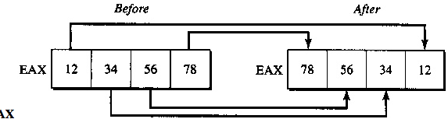
Byte Swap
BSWAP swaps bytes of its operand. For example,
bswap eax
Result is EAX

Slide 26
Signed and Unsigned Integers
Since moving data between registers of different sizes is illegal, you must sign-extend integers to convert signed data to a larger size.
Sign-extending means copying the sign bit of the unextended operand to all bits of the operand's next larger size.
This widens the operand while maintaining its sign and value.
The four instructions presented below act only on the accumulator register (AL, AX, or EAX)

Slide 27
Signed and Unsigned Integers
Instruction | Sign-extend
CBW (convert byte to word) | AL to AX
CWD (convert word to doubleword) | AX to DX:AX
CWDE (convert word to doubleword extended) | AX to EAX
CDQ (convert doubleword to quadword) | EAX to EDX:EAX

Slide 28
Signed Values
.DATA
mem8 SBYTE -5
mem16 SWORD +5
mem32 SDWORD -5
.CODE
.
.
.
mov al, mem8 ; Load 8-bit -5 (FBh)
cbw ; Convert to 16-bit -5 (FFFBh) in AX
mov ax, mem16 ; Load 16-bit +5
cwd ;Convert to 32-bit +5 (0000:0005h) in DX:AX
mov ax, mem16 ; Load 16-bit +5
cwde ; Convert to 32-bit +5 (00000005h) in EAX
mov eax, mem32 ; Load 32-bit -5 (FFFFFFFBh)
cdq ; Convert to 64-bit -5 (FFFFFFFF:FFFFFFFBh) in EDX:EAX

Slide 29
Signed Values
Sign extending instructions efficiently convert unsigned values as well, provided the sign bit is zero.
This example, for instance, correctly widens mem16 whether you treat the variable as signed or unsigned.
The processor does not differentiate between signed and unsigned values.
For instance, the value of mem8 in the previous example is literally 251 (0FBh) to the processor.
It ignores the human convention of treating the highest bit as an indicator of sign.
The processor can ignore the distinction between signed and unsigned numbers because binary arithmetic works the same in either case.
The programmer, not the processor, must keep track of which values are signed or unsigned, and treat them accordingly.

Slide 30
Unsigned Values
If sign extension was not what you had in mind, that is, if you need to extend the unsigned value, explicitly set the higher register to zero:
.DATA
mem8 BYTE 251
mem16 WORD 251
.CODE
.
.
.
mov al, mem8 ; Load 251 (FBh) from 8-bit memory
sub ah, ah ; Zero upper half (AH)
mov ax, mem16 ; Load 251 (FBh) from 16-bit memory
sub dx, dx ; Zero upper half (DX)
sub eax, eax ; Zero entire extended register (EAX)
mov ax, mem16 ; Load 251 (FBh) from 16-bit memory

